Slide 1


A Perfect Saviour at the Right Time!
Made with ♥ from Team Codemons

Slide 2

PARI is an Non Profitable Organisation established to meet the needs of the souls unheard during the hardest of times. We try our best to bridge the gap between the people and the other NGOs. PARI makes sure that the donations are in safe hands and are reached safely.

Slide 3

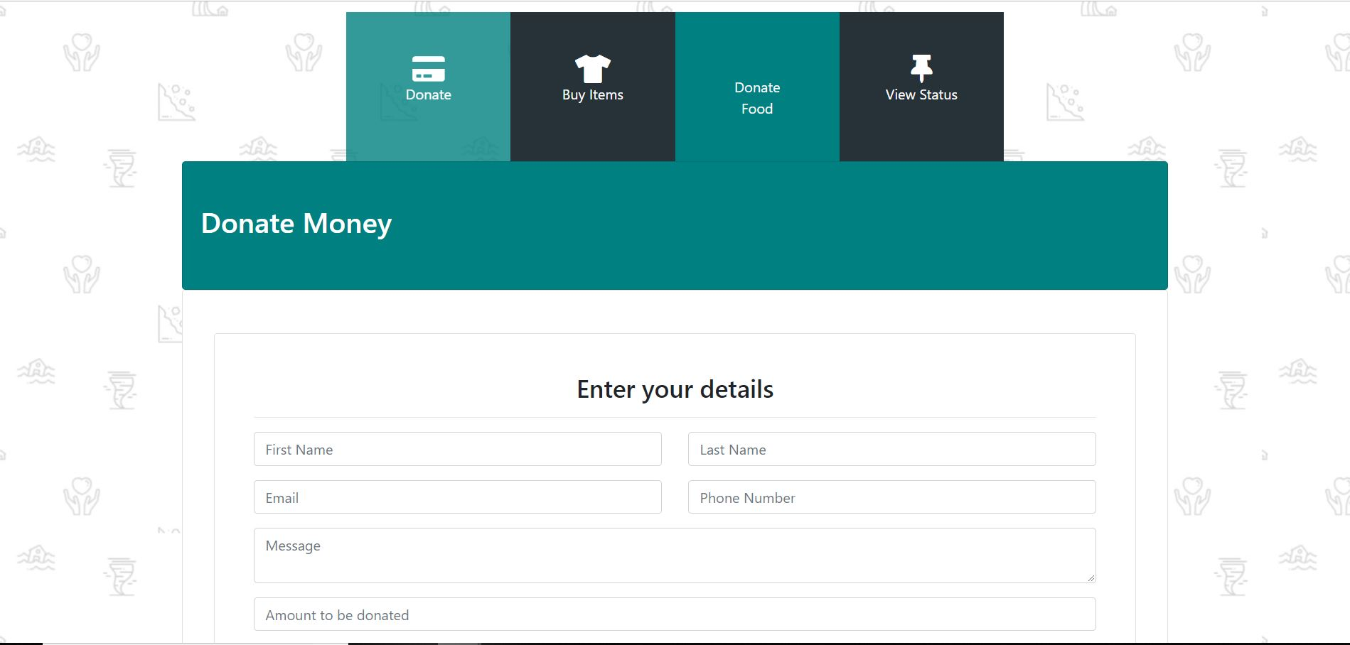
Donations made Easy!
You scan donate money or you can just share the reference code of the order of relief materials with us.
You can also shop for relief items through our portal!
All these donations are directed to NGOs

Slide 4
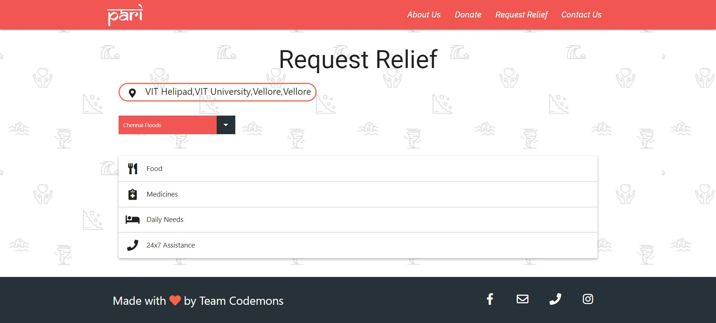
Request Relief
You can select from the list on our portal or you can let us know if you need anything else.
We’ll try our best to satisfy your needs..

Slide 5

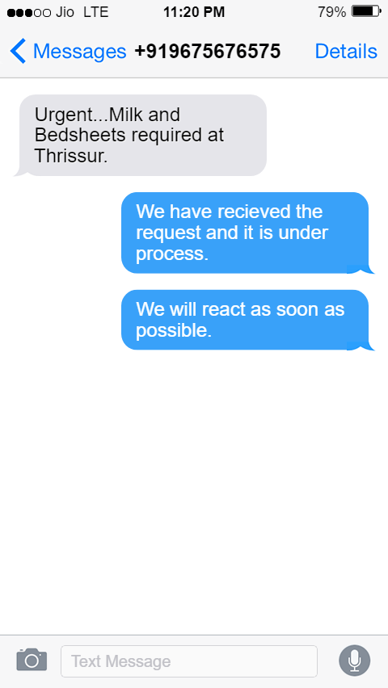
Here comes our Unique Feature…
We can understand that the internet access during a disaster is hard to… So we have an SMS relief feature which allows you to send an SMS regarding the relief material required and the location which will be geotagged and sent to the nearest NGO to you…!

Slide 6
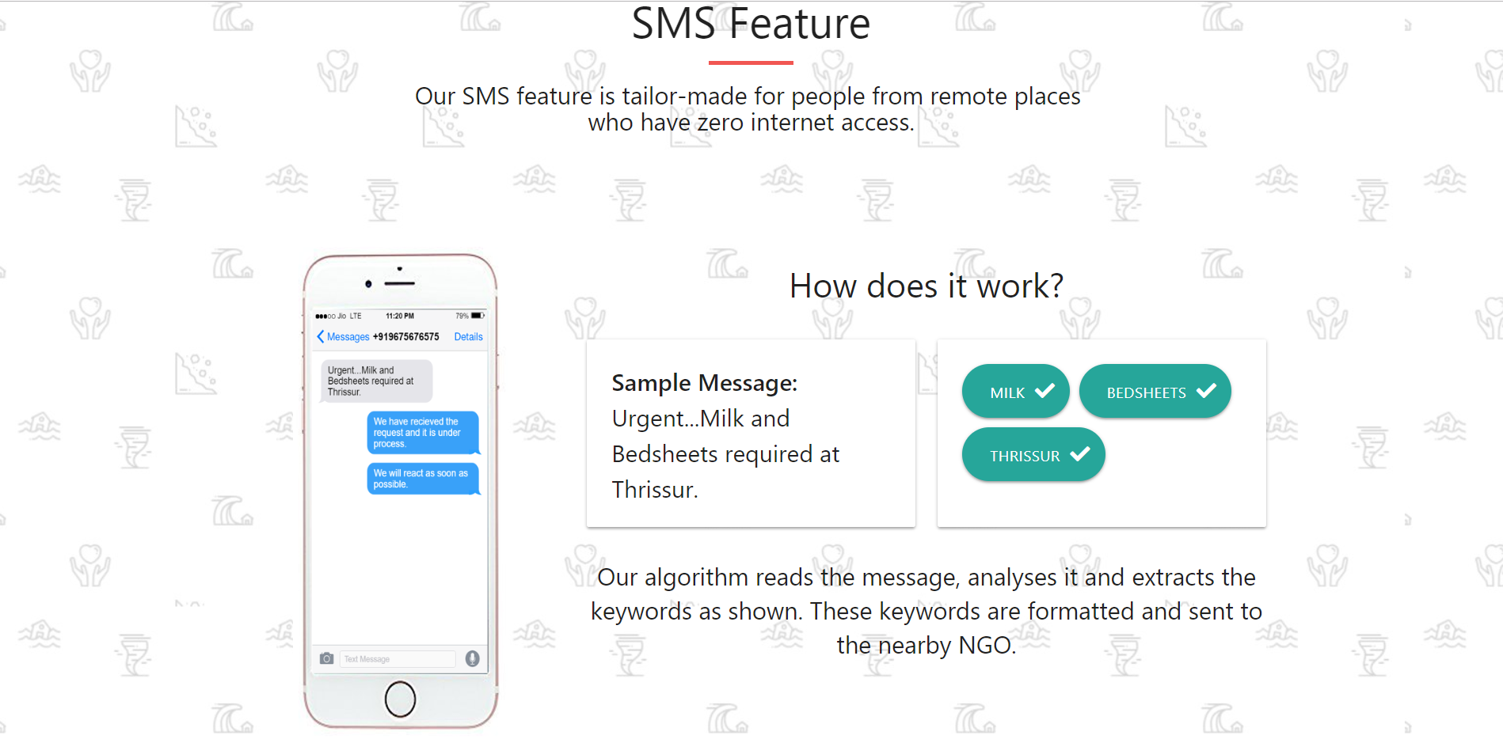

Slide 7

Problem Statement
Running an NGO, the emphasis is not on Profits but the service to the society!
At the same time, the cost model must be kept in mind for the proper functioning of the NGO.

Slide 8

Cost Model
Mode of Publicity | Estimated Cost
Online Publicity | ₹ 7000/Annum
Paper Ads and Posters | ₹ 7000/Annum
Events | ₹ 100000/Annum
Miscellaneous | ₹ 6000/Annum
Total | ₹ 120000/Annum
Type | Estimated Cost
Registration | ₹ 10000-25000
Publicity | ₹120000/Annum

Slide 9

Our Revenue Plan
Few options for revenue generation for the functioning of the organisation,
Government Funds
Fundraising Events
Private Donations
Funds from Stalls during Expos

